Slide 1

7th Grade Math
Unit 7, Lesson 1 Circle Graphs Volume 1, pg. 293

Slide 2


Benchmark
MA.7.DP.1.4
Use proportional reasoning to construct, display, and interpret data in circle graphs.
volume 1, pg. 293

Slide 3
Integrated Mathematical Thinking and Reasoning Standards
MA.K12.MTR.2.1 Demonstrate understanding by representing problems in multiple ways.
MA.K12.MTR.5.1 Use patterns and structure to help understand and connect mathematical concepts.
MA.K12.MTR.6.1 Assess the reasonableness of solutions.
volume 1, pg. 293

Slide 4

Learning Target
I can show how an angle measure is related to a portion of a circle.
volume 1, pg. 293

Slide 5

Warm-Up
volume 1, pg. 293

Slide 6
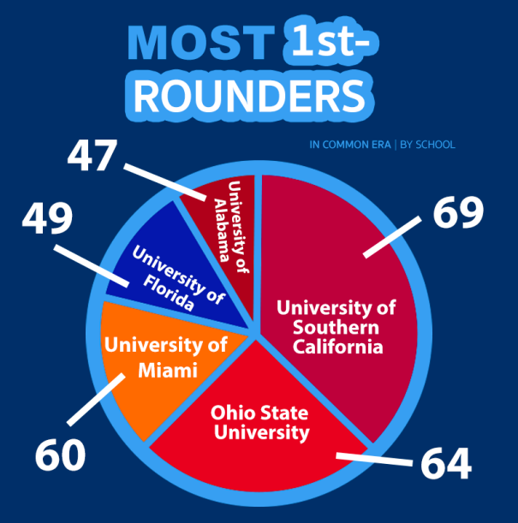
7.1.1 Warm-Up: NFL Draft
The circle graph shows the number of National Football League’s (NFL) first round picks for five schools for the common era ending in 2017.
What do you notice about the circle graph?
volume 1, pg. 293

Slide 7
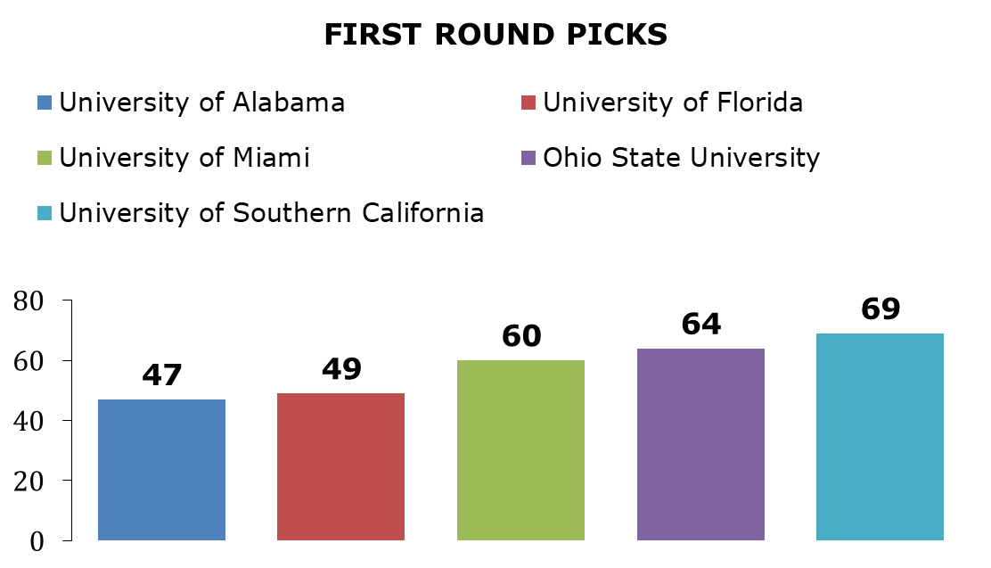
A data scientist created a bar chart for the same data.
Describe how the bar chart better represents the data than the circle graph.
volume 1, pg. 293

Slide 8

Exploration
volume 1, pg. 294

Slide 9

7.1.2 Exploration: Sectors and Circles
A sector is a fractional part of the area of a circle.
There are six congruent circles drawn below. Use a protractor to divide the circles into sectors that represent halves, thirds, fourths, fifths, sixths, and eighths, as indicated.
Halves
Thirds
volume 1, pg. 294

Slide 10
Fourths
Fifths
Sixths
Eights
volume 1, pg. 294

Slide 11
Complete the table with the fraction and percentage of the whole circle that each congruent sector represents.
Sector | Fraction | Percentage
Halves
Thirds
Fourths
Fifths
Sixths
Eighths
volume 1, pg. 294

Slide 12

Collaboration
volume 1, pg. 295

Slide 13

7.1.3 Collaboration: Dividing Circles into Sectors
In the Exploration, all of the circles were divided into congruent sectors. Data displayed in circle graphs are not typically divided equally among each category.
Use the circle on the coordinate grid to answer the following questions.
Discuss with your partner how to divide the circle into a half and two quarters.
Use a straight edge to divide the circle. Label each sector with the fraction and percentage of the whole circle the sector represents.
volume 1, pg. 295

Slide 14
What is the sum of all the fractions in the labeled circle?
What is the sum of all the percentages in the labeled circle?
Use the circle on the coordinate grid to answer the following questions.
Discuss with your partner how to divide the circle into a half, a third, and a sixth.
Use a straight edge to divide the circle. Label each sector with the fraction and percentage of the whole circle the sector represents.
volume 1, pg. 295

Slide 15
What is the sum of all the fractions in the labeled circle?
What is the sum of all the percentages in the labeled circle?
Consider a circle divided into any number of sectors.
What should be the sum of all fractions in order to represent the area of the whole circle?
What should be the sum of all the percentages in order to represent the area of the whole circle?
volume 1, pg. 296

Slide 16

Guided Instruction
volume 1, pg. 296

Slide 17

7.1.4 Guided Instruction: Determining Central Angle Measures
A diagram of a circle with four congruent sectors is shown.
Use the definition of a central angle to determine how many central angles are in the circle with four congruent sectors.
An angle is formed wherever two lines, segments, or rays intersect. Angles are measured in degrees.
A central angle has its vertex at the center of a circle with radii as its sides.
volume 1, pg. 296

Slide 18
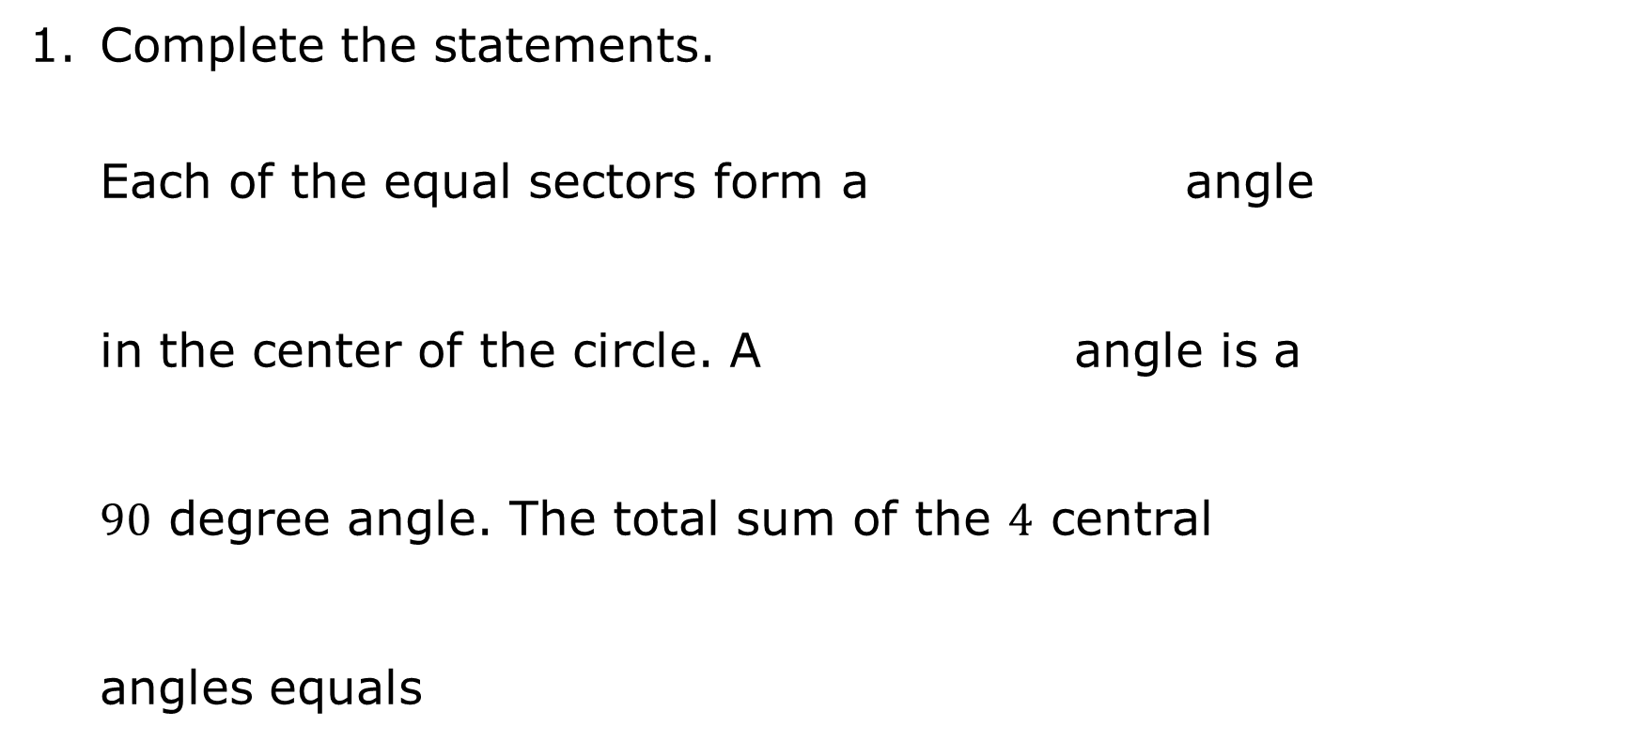
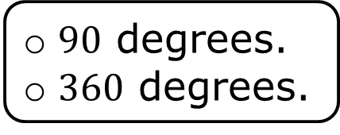
Complete the statements.
Each of the equal sectors form a angle in the center of the circle. A angle is a $90$ degree angle. The total sum of the $4$ central angles equals
right
straight
right
straight
$90$ degrees.
$360$ degrees.
volume 1, pg. 296

Slide 19
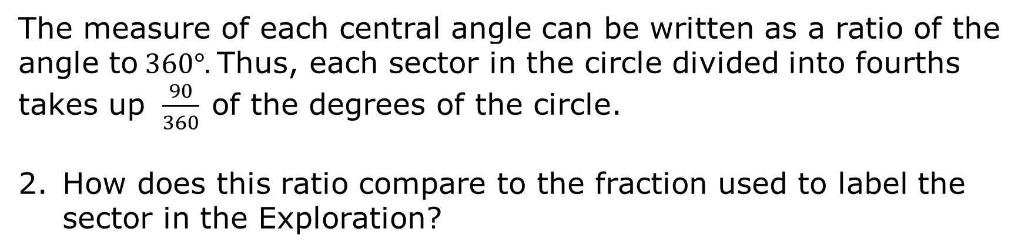
The measure of each central angle can be written as a ratio of the angle to $360°$. Thus, each sector in the circle divided into fourths takes up $\frac{90}{360}$ of the degrees of the circle.
How does this ratio compare to the fraction used to label the sector in the Exploration?
volume 1, pg. 297

Slide 20
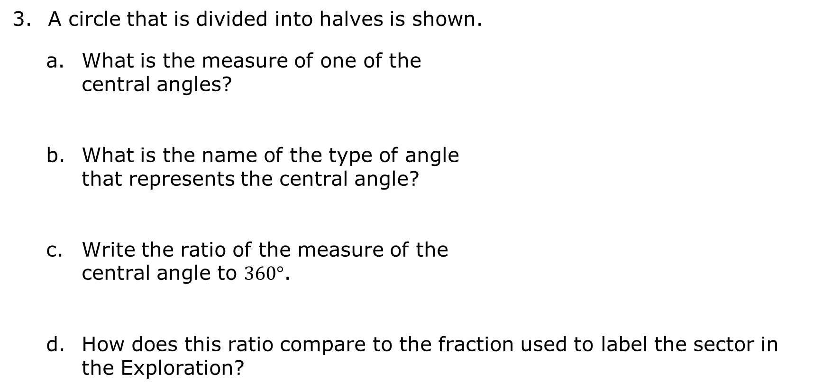
A circle that is divided into halves is shown.
What is the measure of one of the central angles?
What is the name of the type of angle that represents the central angle?
Write the ratio of the measure of the central angle to $360°$.
How does this ratio compare to the fraction used to label the sector in the Exploration?
volume 1, pg. 297

Slide 21
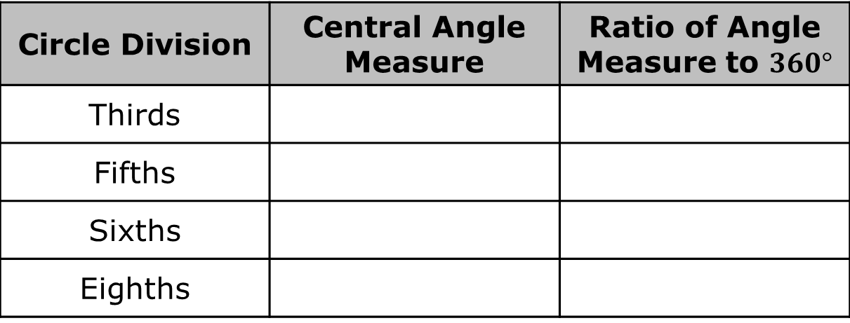
Answer the following with your partner.
If a circle is divided into any number of congruent sectors, how can the central angle measures be calculated? Summarize your discussion.
Based on your discussion, fill in the table.
Circle Division | Central Angle Measure | Ratio of Angle Measure to $360°$
Thirds
Fifths
Sixths
Eighths
volume 1, pg. 297

Slide 22
Compare the ratios in the table to the fractions used to label the circles in the Exploration. Discuss what you notice with your partner.
Write a conjecture of how the angle measure ratio relates to the amount of a circle.
volume 1, pg. 298

Slide 23

Wrap-Up
volume 1, pg. 298

Slide 24
7.1.5 Wrap-Up: Reflection
Complete each statement based on your understanding of today’s lesson.
I am still unsure about ____________________ _______________________________________ ______________________________________.
One question I have that will help me better understand is ___________________________ ______________________________________ ______________________________________?
volume 1, pg. 298

